Slide 1
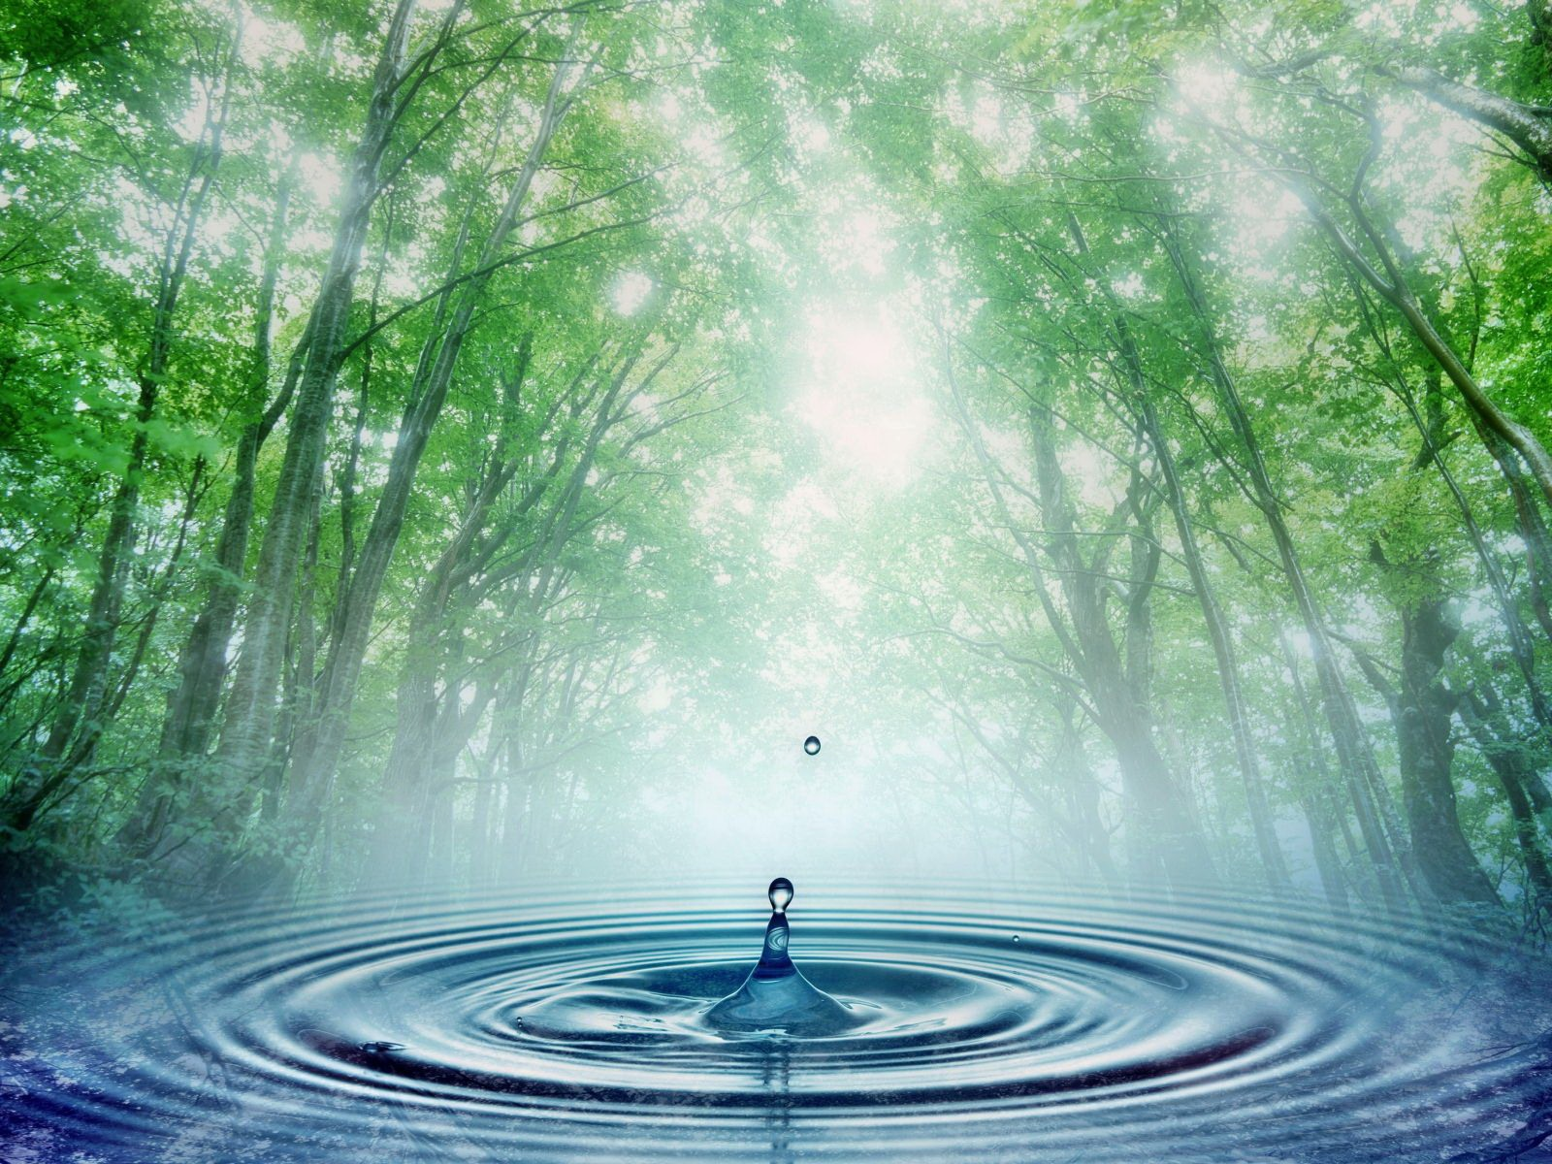
Prescribing Nature for a Healthier Life

Slide 2
Outcomes
Provide research to inform participants of the benefits of spending time in nature
Share ideas for activities for all ages to interact with the natural world
Experience the benefits of engaging with nature

Slide 3
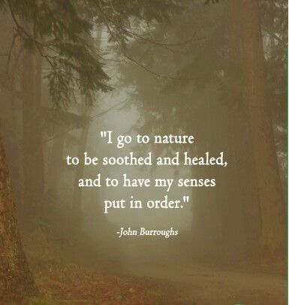

Slide 4
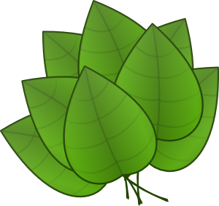
Why Prescribe Nature?
Nature Soothes
Nature Connects
Nature Heals
Nature Restores

Slide 6
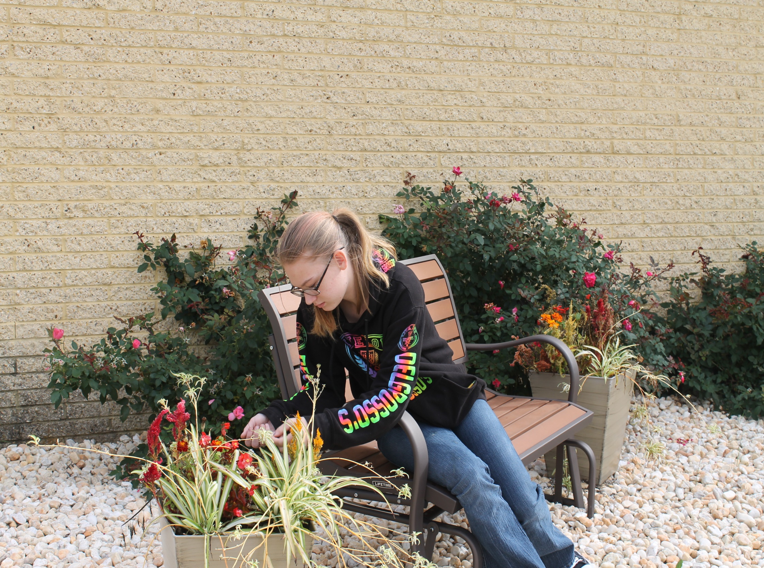
“Working in the greenhouse is
therapeutic and calming.”
- Crista

Slide 7
Social and Practical Skills
“Key findings of a case study of …preschool and kindergarteners’ learning when they were engaged in hands-on activities in the garden and greenhouse areas of a model outdoor classroom suggest that …they are
Communicating their knowledge about the world to others,
Conveying (and learning to process and manage) emotions, and
Developing important skills (e.g., initiative, self-confidence, literacy, math, science skills) that will help them be more successful in school and better navigate the world.”
(Miller, 2007)

Slide 8
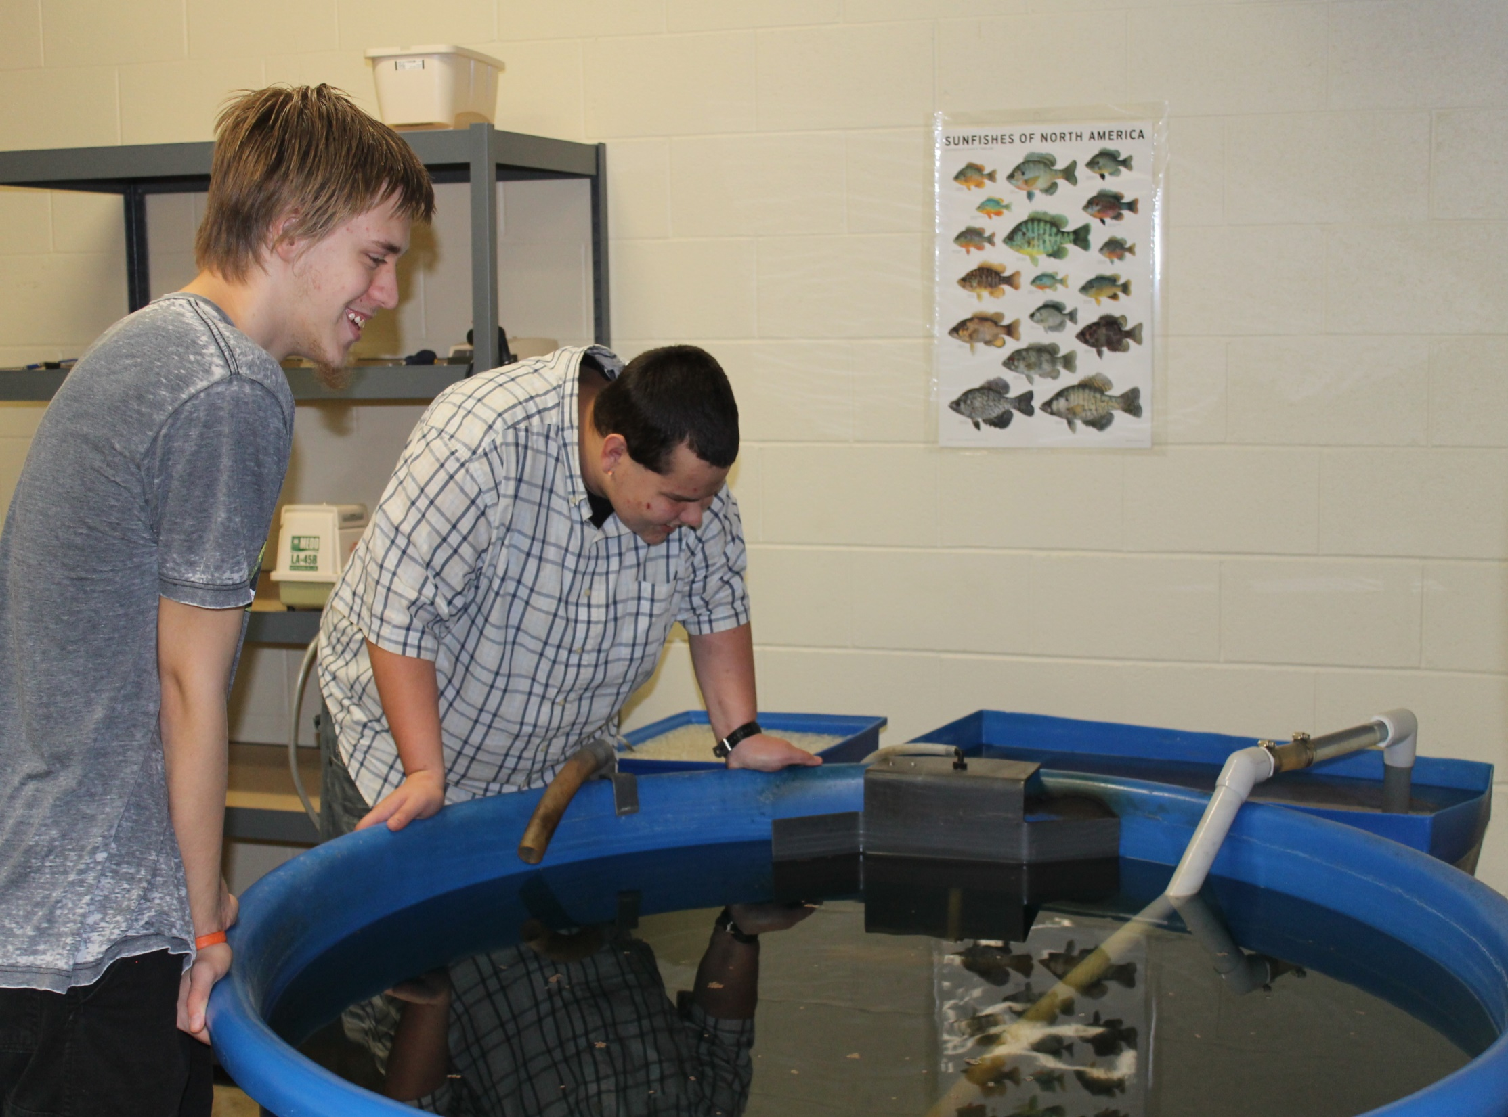
Nature Connects
Aquaculture
Programs

Slide 9
Nature Connects
Human Environment Research Lab
Kuo and Coley reported:
A Greater Sense of Community
Babies, Children and Toddlers
Time in nature connects us to each other and the larger world.
Creates stronger feelings of unity with neighbors, being more concerned with helping and supporting each other.
Reduced risk of street crime, lower levels of violence and aggression, and a better capacity to cope with life’s demands-especially the stresses of living in poverty.
Connecting to the natural world…
Is crucial for optimal intellectual and physical development
Provides a sense of refuge and healing in a sometimes violent and frightening world
Helps them grow into adults who care about environmental stewardship
NACC 2007

Slide 10
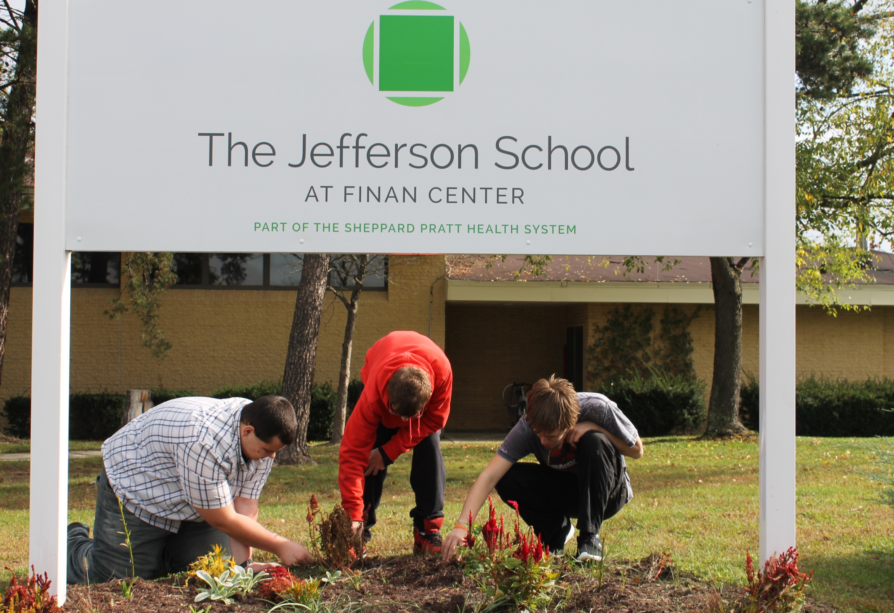
Nature Heals

Slide 11
Nature Heals
Found lower cortisol levels in those who took forest walks compared with those who walked the same difference in a lab
Rx: 50 mg Nature, Ad Lib
(Youshifumi Miyazaki)
Chiba University – Japan
“We see pharmaceuticals, gyms, standing and walking desks as a fair trade for the outdoors…the research suggests they are not enough
Stephen Kellert
Social Ecologist
Dr. Robert Zarr and his team at Unity Healthcare in Washington, DC have begun prescribing time outside in nature for conditions as wide-ranging as ADHD, high blood pressure, asthma, obesity, anxiety, diabetes and depression.

Slide 12
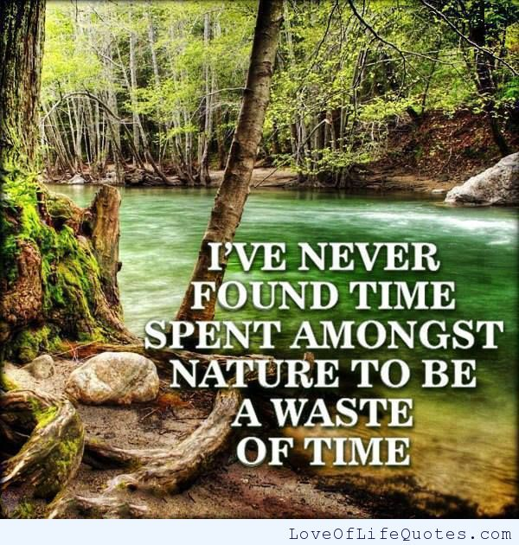

Slide 13
Schools with Environmental Education Programs
Score higher in math, reading, writing and listening
Experience increases in critical thinking and social skills

Slide 14
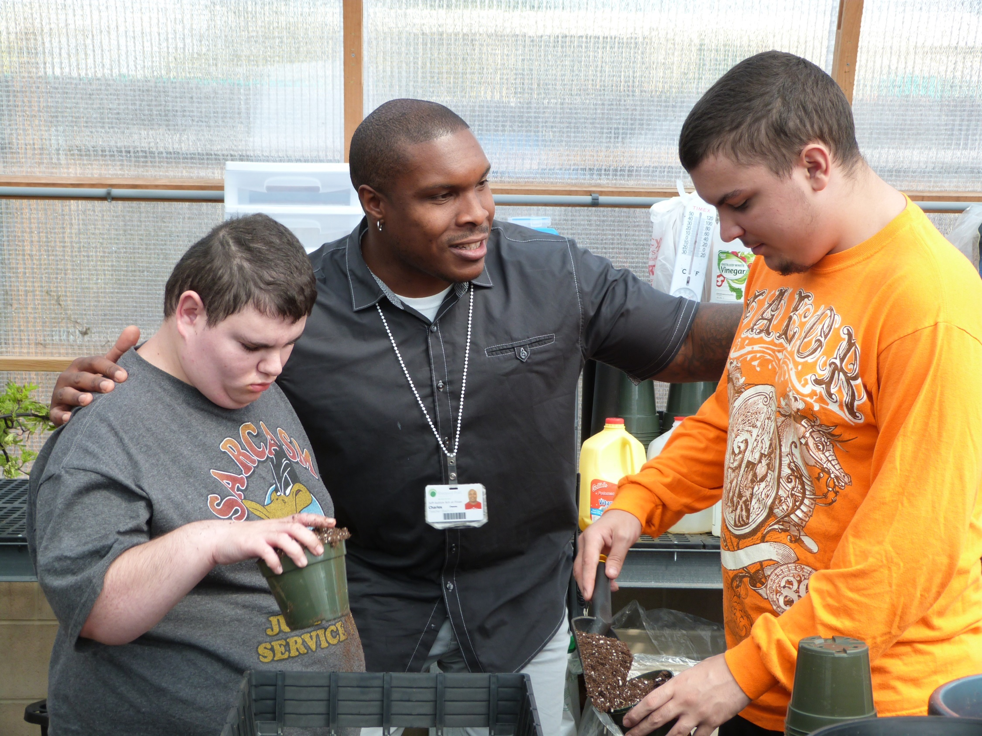
Nature Soothes

Slide 15
Nature Soothes
Being in nature, or even viewing scenes of nature reduces anger, fear and stress within minutes and makes you feel better physically and emotionally.
It reduces blood pressure, heart rate, muscle tension and the production of stress hormones
Not only does it improve your mood but effects how your nervous, endocrine and immune systems are working.
Nature is important to development in every major way – intellectually, emotionally, socially, spiritually and physically.
(Kellert, 2005)
From Benefits of Connecting Children to Nature-NC State University

Slide 16
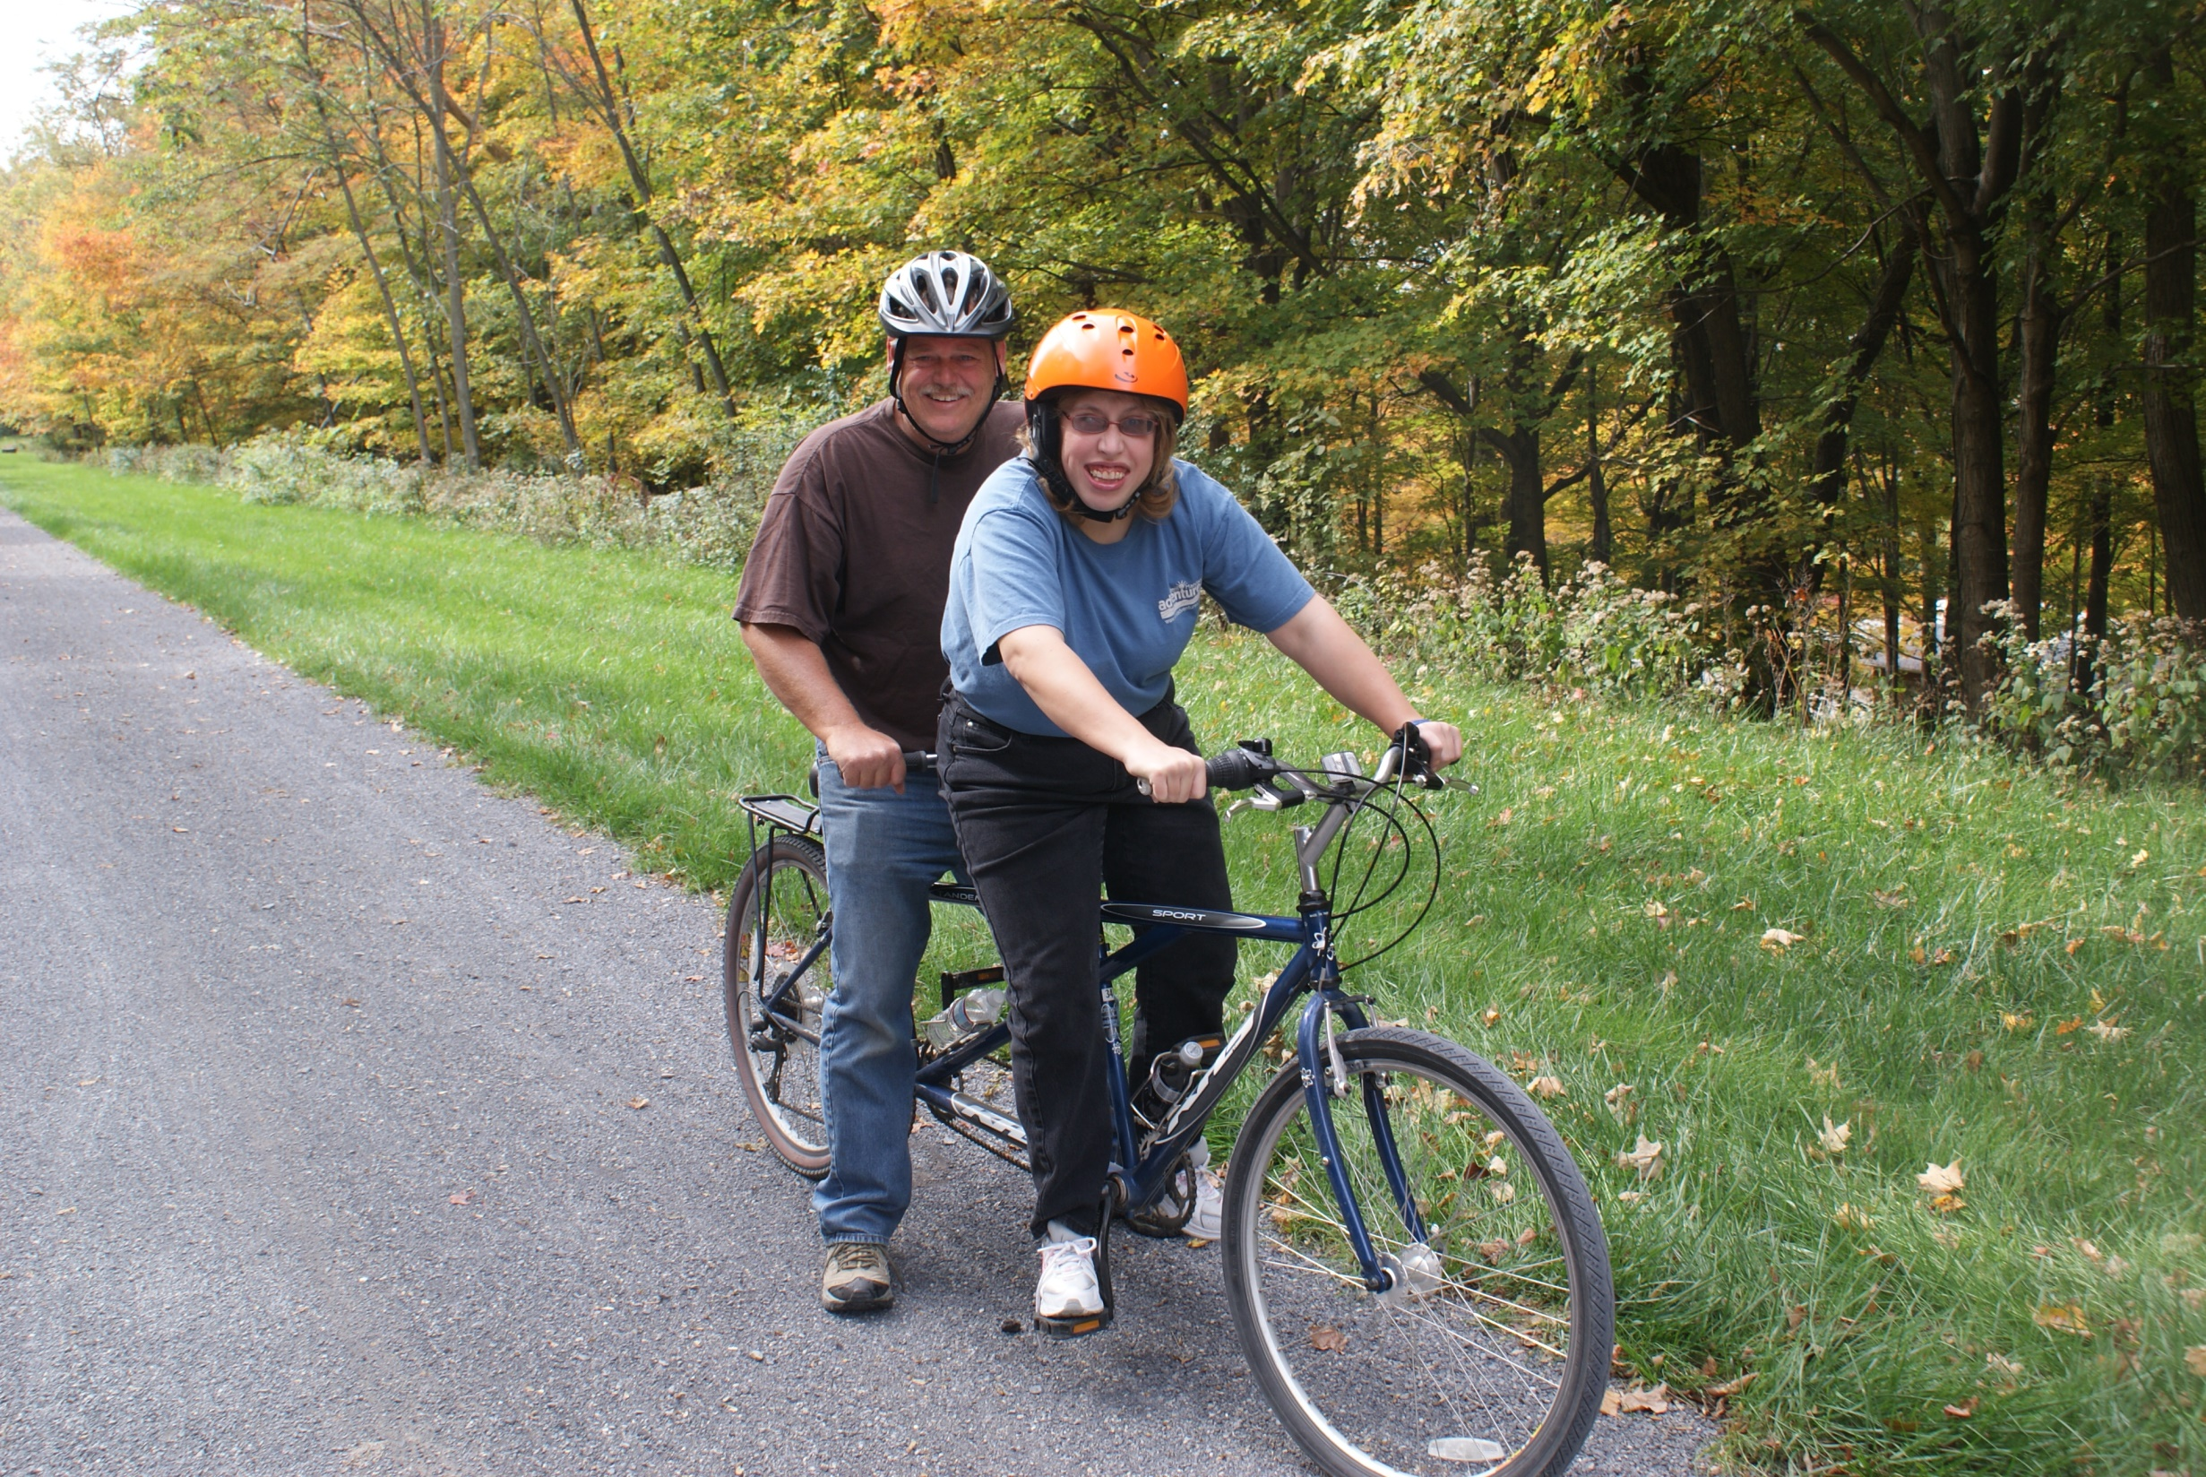

Slide 17
Nature Heals
Even the scent of nature may be beneficial: chemicals secreted by trees, know as phytoncides, have been linked with improved immune defense as well as a reduction in anxiety and increase in pain threshold.
Long lasting influence on immune system markers, increased activity of antiviral cells and intracellular anti-cancer proteins remaining significant for a full week after the visit.
Rx: 50 mg Nature, Ad Lib
(Youshifumi Miyazaki)
Chiva University – Japan

Slide 18
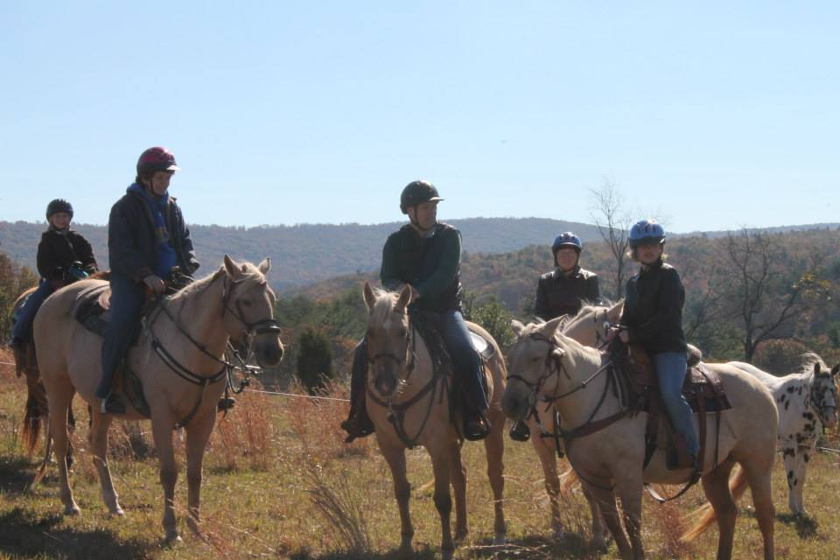

Slide 20
Nature Restores
Supports creativity and problem solving
Enhances cognitive abilities
Improves academic performance
Reduces Attention Deficit Disorder symptoms
Increases physical activity levels
Improves nutrition
Improves eyesight
Improves social relations
Improves self discipline
Reduces stress
Benefits of Connecting Children with Nature

Slide 21
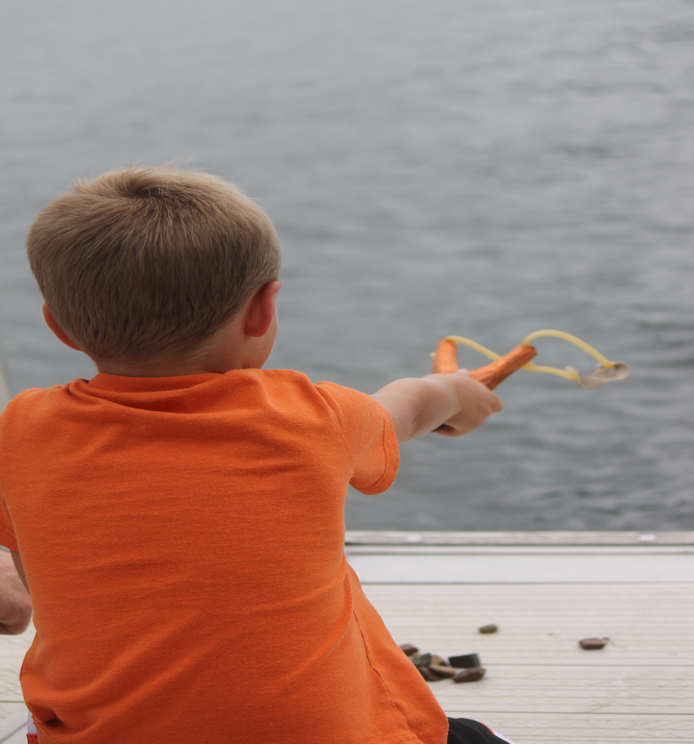
Research shows that children are spending ½ the time outdoors than they did 20 years ago.
Childhood obesity rates have doubled the last 20 years; the US has become the largest consumer of ADHD medications in the world and pediatric prescriptions for antidepressants have risen.

Slide 22
What Do We Do When We Get There?
Hiking or walking in the woods
Biking on the wooded trails
Gardening or aquaculture projects
Sitting quietly observing landscape
Kayaking, paddle boarding or canoeing on the waters
Geocaching
Kite Flying
Building animal habitat
Volunteering in parks – bird banding, butterfly tagging, trail marking, etc
Wildflower walks
Nature Journaling
Stream search
Fishing
Art in Nature – painting, sketching or photography
Tree ID walks
Natural History Walks
Creating a nature trail
Designing and creating a backyard or schoolyard habitat
Guided imagery
Explore a pond for wildlife
Reading and writing outside
Go on an Owl Prowl
Explore bug, slugs and other misunderstood populations
Adopt a nature-based project

Slide 23
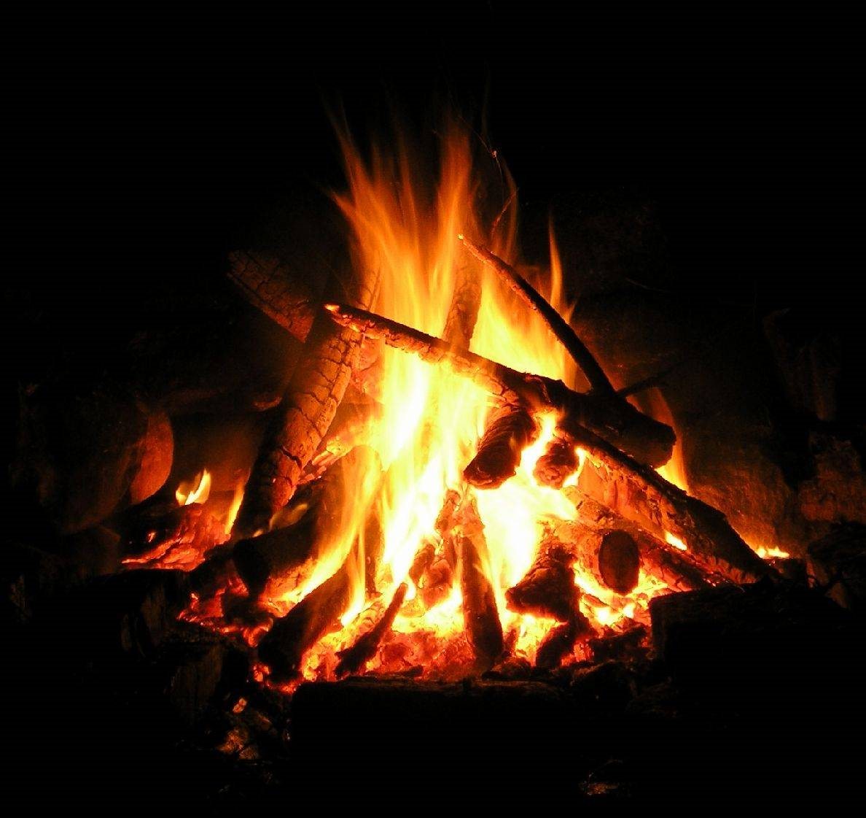
More Things To Do When You Get There
Toss rocks into the water
Snowshoe
Cross Country Ski
Downhill Ski
Micro hikes
Explore the night sky
River clean up
Visit overlooks
Tree plantings
Learn about the nature things you love
Whitewater Rafting
Rock Climbing
Rappelling
Night hike
Watch cloud formations
Picnic
Sit by a campfire

Slide 24
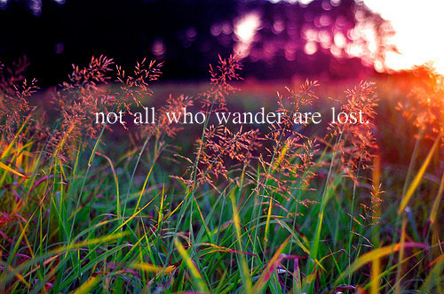

Slide 25
