Slide 1
Overview of Court Ordered Treatment
Ron Honberg, J.D.
National Director of Policy and Legal Affairs
NAMI
October 20, 2013

Slide 2
“The basis of a democratic state is liberty.” Aristotle, 384 BC

Slide 3
“The measure of a great society is how it treats its most vulnerable citizens.” Hubert Humphrey

Slide 4
“What was I thinking when I agreed
to do this presentation??” Ron Honberg, 2013

Slide 5
The Context
We are only talking about a small group of people.
These are the individuals who are at most risk and who cost the system the most.
“It cost us one million dollars not to do something about Murray.”
Officer Patrick O’Bryan, Las Vegas P.D., quoted in Malcolm Gladwell’s “Million Dollar Murray,” New Yorker, Feb. 13, 2006

Slide 6
It’s a Balance…
Less than half of all people with mental illnesses receive minimally adequate treatment.
Why?
Treatment is often not available.
Treatment sometimes doesn’t work.
Many have had bad experiences with the system.
Some make informed choices not to participate.
Others refuse help due to lack of insight (Anosognosia).

Slide 7
Unawareness of Mental Disorder
(Xavier Amador, Ph.D)
N = 221, patients with schizophrenia
http://tacreports.org/storage/documents/no_room_at_the_inn-2012.pdf

Slide 8
Limited Authority of States to Involuntarily Confine or Treat
To protect public safety
Police power
To help people unable to help themselves
“Parens Patriae”

Slide 9
Current NAMI Policy
Involuntary inpatient/outpatient commitment/court ordered treatment should be last resort.
State standards should include:
Gravely disabled (substantially unable to provide for basic needs).
Likelihood of substantial deterioration if timely treatment is not provided.
Lack of capacity.
Past history should be considered.
Court ordered outpatient treatment (assisted outpatient treatment or AOT) should be considered as less restrictive alternative.

Slide 10
Proposed changes to Inpatient Commitment Criteria in MD.
Current law- “person present a danger to the life or safety of the individual or of others”.
Bill attempts to broaden criteria to:
Include consideration of past history;
Include in definition: “substantial risk … of bodily harm, significant psychiatric deterioration, etc. as consequence of inability, without supervision and assistance of others, to satisfy … need for nourishment, personal or medical care, shelter, or self-protection and safety.”

Slide 11
Does Broadening Commitment Criteria make a Difference?
Surprisingly few studies.
Eight state study in 1992 found no modest or no increases in commitments following broadening of criteria.
Numbers of commitments in several states actually decreased.
May reflect early intervention, fewer psychiatric emergencies.
External social pressures following tragedies may be more of a factor than language in statutes.

Slide 12
What is Outpatient Commitment?
Also known as Assisted Outpatient Treatment (AOT).
Court order compelling person to participate in treatment in the community.
43 states currently authorize AOT.
The option of AOT is rarely used in a number of states.
Some states (e.g. Wisconsin, New York, Ohio and North Carolina) use it frequently.

Slide 13
Potential Benefits of AOT
Continuity of care (if properly structured).
Less restrictive placement (remain in community).
Less expensive than inpatient treatment.
Therapeutically more beneficial than inpatient commitment (which is frequently a short-term emergency response).
Less stigma than hospitalization.
Places responsibility on mental health system and providers to deliver services.

Slide 14
Concerns Raised about AOT
Need adequate infrastructure of community mental health services and supports.
Effective implementation requires immediate resources.
What happens if mental health system does not adhere to order?
Some concern that engagement in treatment lasts only for duration of order.
Divides advocates along ideological lines.

Slide 15
Does AOT Work?
Studies are mixed, but majority suggest that outpatient commitment can be effective in:
Reducing hospitalizations.
Reducing lengths of stays when re-hospitalizations do occur.
Enhancing participation in community services.
Length of order may improve outcomes.
Are positive outcomes attributable to court orders or enhanced services?
Consumer perceptions of coercion may be influenced as much by the treatment experience as the “voluntary” or “involuntary” nature of the engagement in treatment.
“Voluntary” treatment can be highly coercive and “involuntary” treatment can be non-coercive.

Slide 16
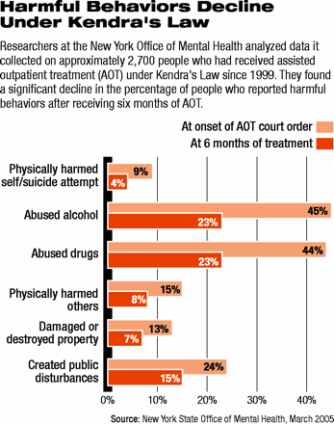

Slide 17
Other Treatment Engagement Options
Assertive Community Treatment (ACT)
Proven effectiveness in help people most at risk of “falling through the cracks”.
Psychiatric Advance Directives
Opportunities for consumers to state treatment preferences, assign substitute decision-makers, when competent.
Peer services and supports
Although limited research, mutual support, shared experiences, may lead to good outcomes.

Slide 18
Questions or Comments?
“I wish I had an answer to that, because I’m tired of answering that question.” Yogi Berra

Slide 19
Thank you!

